Slide 1

SYMBIOSIS Center for Distance Learning
Project Idea Presentation
Online Clothes Shop
Presented By
Samruddhi Mohite
Amruta Umbarkar
Geetanjali Pandit
Anjali Dangade
Guided By
Prof. Raj Kolhe
Batch Number
SDAJ36

Slide 2
Content
Introduction
Objective
Product
Future Scope
Features
Conclusion

Slide 3
Introduction
E-Commerce is the simple shopping solution. It’s a shopping cart system.
The basic concept of the application is to allow the customer to shop virtually using the internet and allow customers to buy the items and articles of their desire from the store.
Shopping is the essential part of our life. We are using different types of shops to buy different kinds of products in our everyday life.

Slide 4
Objective
To develop a user-friendly digital platform for online shopping.
Mention the intention to streamline the ordering process, reduce errors, and enhance customer satisfaction.
Highlight the aim to provide a convenient and efficient solution for customers.
The purpose of the project is to build an application program to reduce the manual work for managing the Order.

Slide 5
Product
Clothes:
1.Women
2.Men
3.Kids

Slide 6
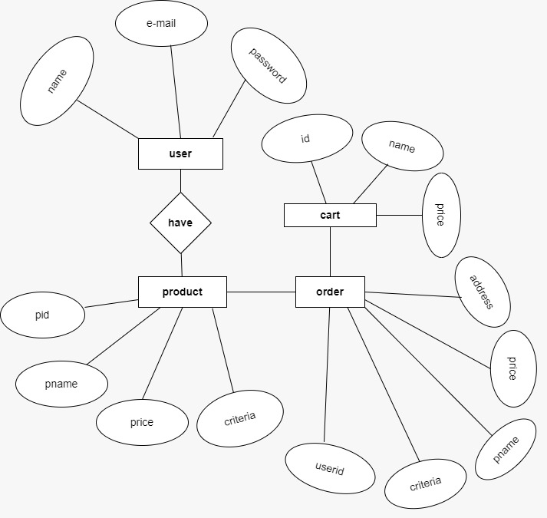

Slide 7
Future Scope
Its main aim is to simplify and improve the efficiency of the ordering process for customer.
Customers will also be able to view product menus and their category.

Slide 8
Features
It overcomes all the problems of existing system clothes can be order in more convenient way.
It makes system very effective for ordering a clothes.

Slide 9
Conclusion
Our project is only a humble venture to satisfy the needs to manage their project work.
Several user friendly coding have also adopted.

Slide 10
Thank you

